Slide 1

MIMIC-III NLP
Ankita Savaliya
AI in Healthcare

Slide 2
What Disease Did I Pick?
I selected disease codes related to 401.0 – Malignant Essential Hypertension. Malignant essential hypertension is a severe and life-threatening form of high blood pressure that develops rapidly and can cause damage to multiple organs.
What About the Text Data?
The objective of this analysis is to extract medical entities using Spacy, SciSpacy, Word2Vec, and t-SNE plots.
Additionally, used MedSpacy to perform a similar analysis.
GitHub and Google Colab Links:
https://colab.research.google.com/github/AnkitaSavaliya/AIH/blob/main/MIMIC-III_NLP.ipynb
https://github.com/AnkitaSavaliya/AIH/blob/main/MIMIC-III_NLP.ipynb
https://github.com/AnkitaSavaliya/AIH/blob/main/MIMIC-III%20NLP.pptx

Slide 3
What Disease Did I Pick?​
I selected disease codes related to 401.0 – Malignant Essential Hypertension. Malignant essential hypertension is a severe and life-threatening form of high blood pressure that develops rapidly and can cause damage to multiple organs.​
​
What About the Text Data?​
The objective of this analysis is to extract medical entities using Spacy, SciSpacy, Word2Vec, and t-SNE plots.​
Additionally, used MedSpacy to perform a similar analysis.​
​
GitHub and Google Colab Links:​
https://colab.research.google.com/github/AnkitaSavaliya/AIH/blob/main/MIMIC-III_NLP.ipynb​
https://github.com/AnkitaSavaliya/AIH/blob/main/MIMIC-III_NLP.ipynb​
https://github.com/AnkitaSavaliya/AIH/blob/main/MIMIC-III%20NLP.pptx

Slide 4
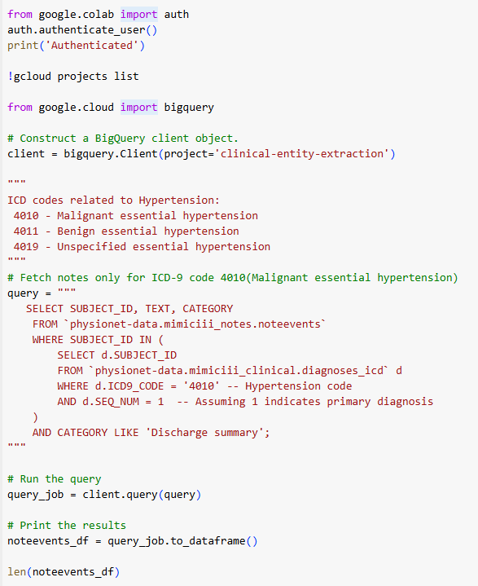
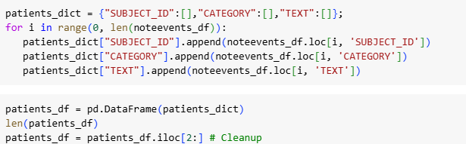
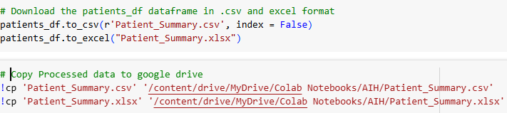
Data Preparation
Fetched rows from noteevents only for ICD-9 CODE 4010 using the BigQuery client.
The query returned 162 rows.
Prepared a DataFrame with the required columns.
Saved the query result to a CSV/XLSX file to reduce queries to the database.

Slide 5
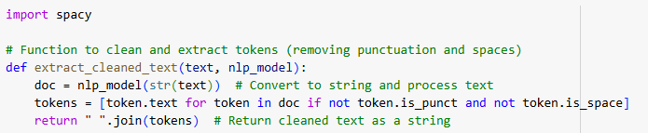
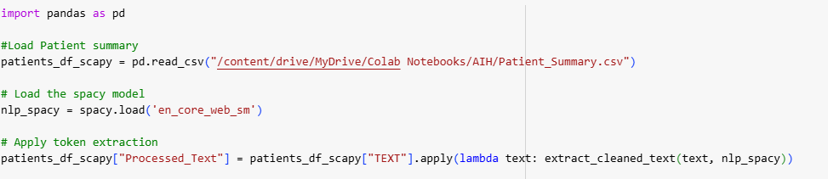
Common Function to Extract Tokens Using a Given NLP Model (SpaCy/SciSpaCy)
Process TEXT using SpaCy (Remove punctuation and spaces)

Slide 6

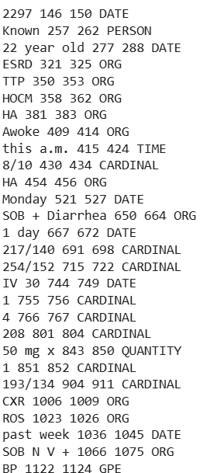
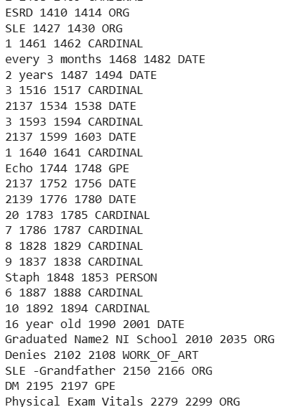
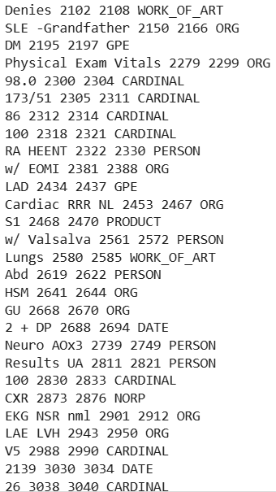
Extract Entities Using Spacy

Slide 7
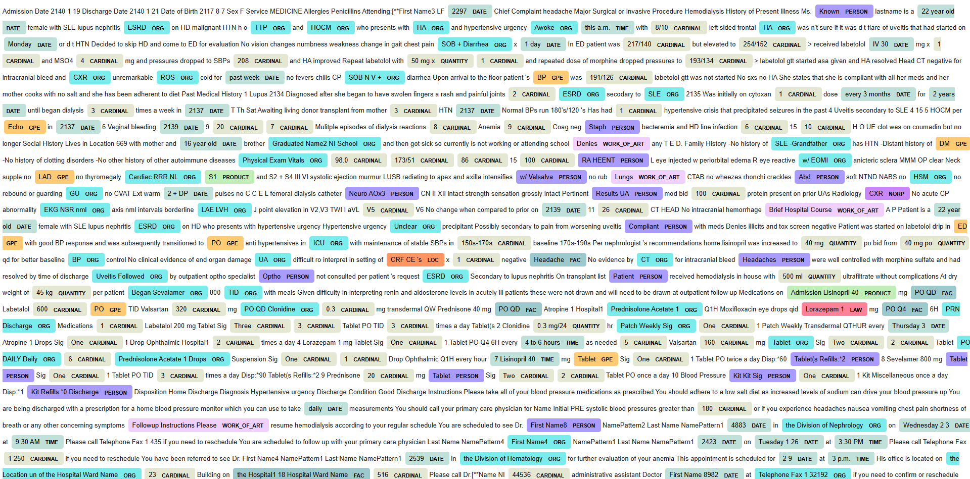
Visualize SpaCy Entities Using displaCy

Slide 8
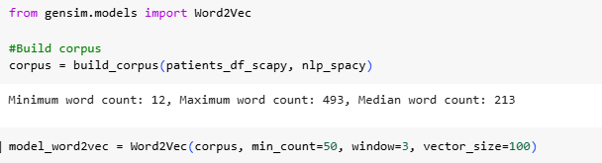
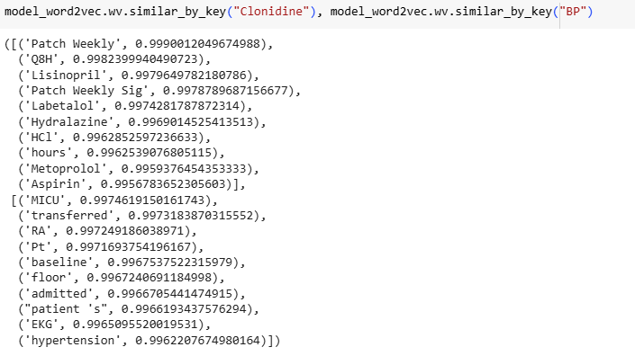
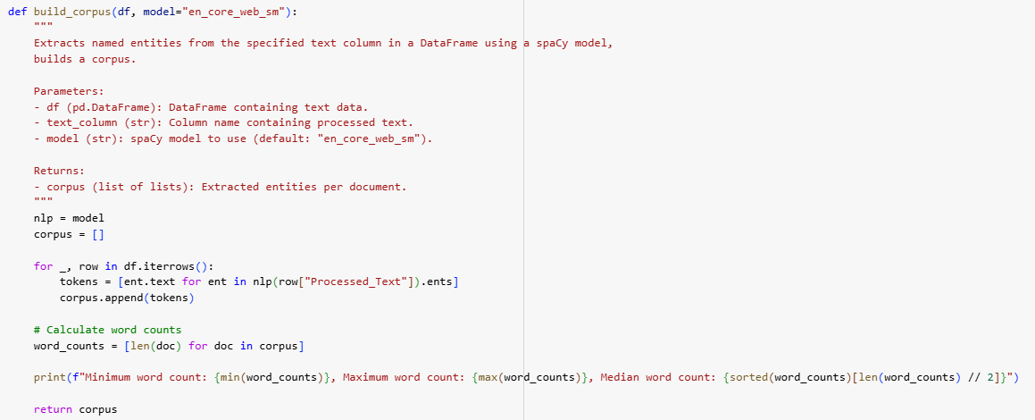
Word2Vec and t-SNE Visualization Using SpaCy-Processed Data
Created common function to build corpus using given model SpaCy/SciSpaCy

Slide 9
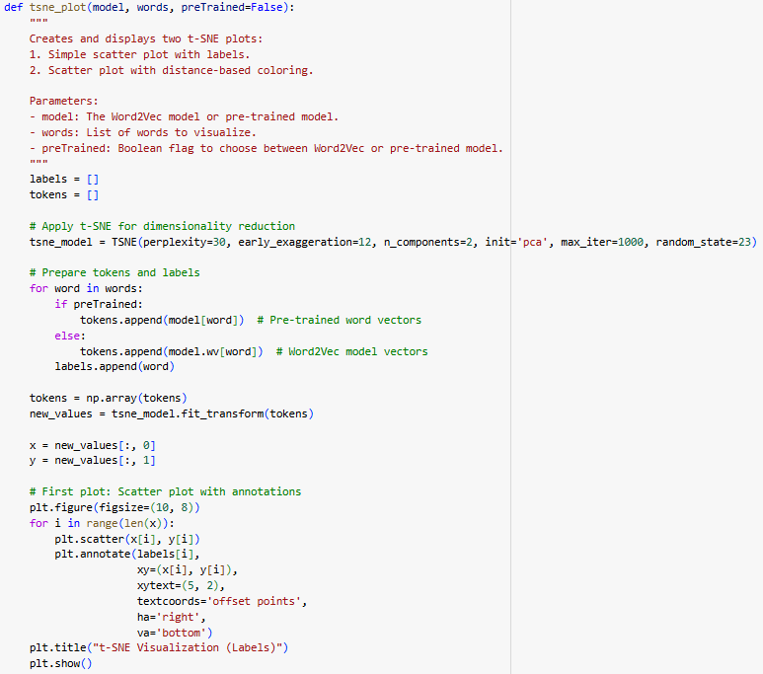

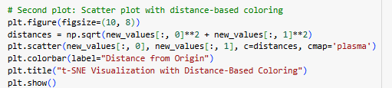
Define common function for t-SNE plot which creates two plots(with labels and with distance-based coloring)
Call function using corpus built using Spacy processed text.

Slide 10
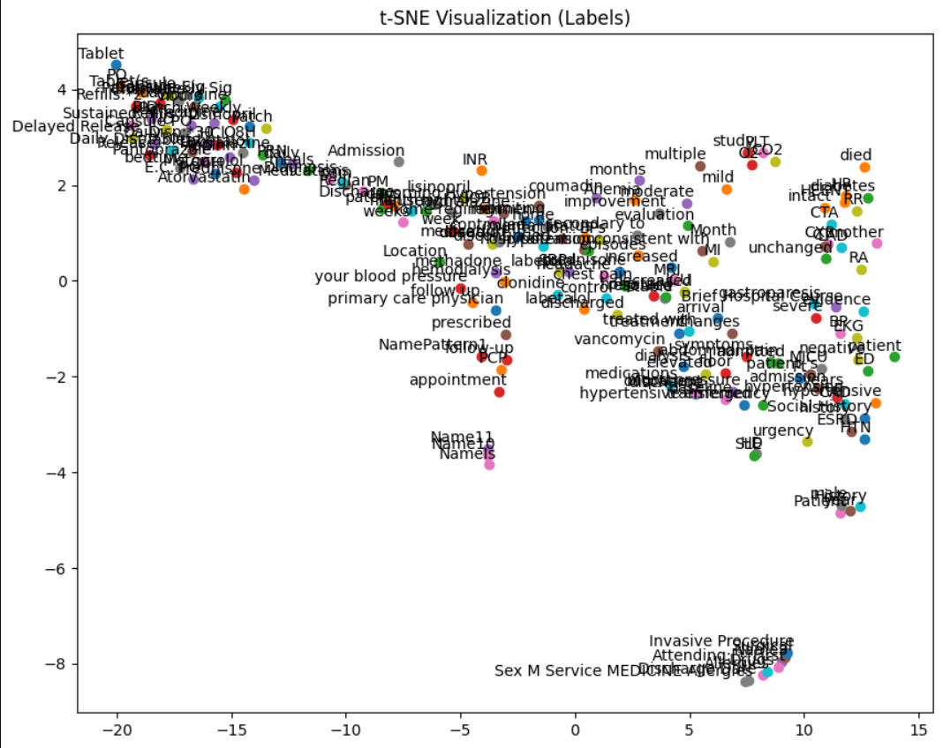
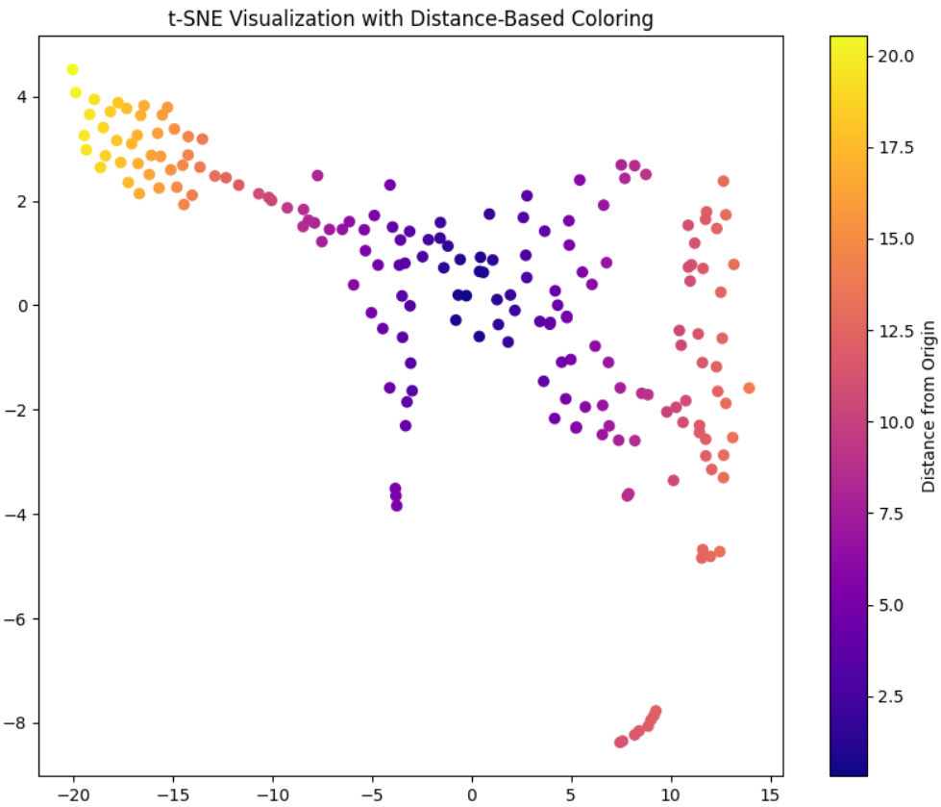

Slide 11
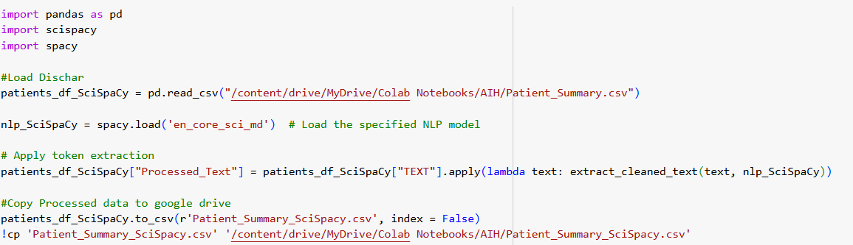
Process TEXT using SciSpaCy

Slide 12
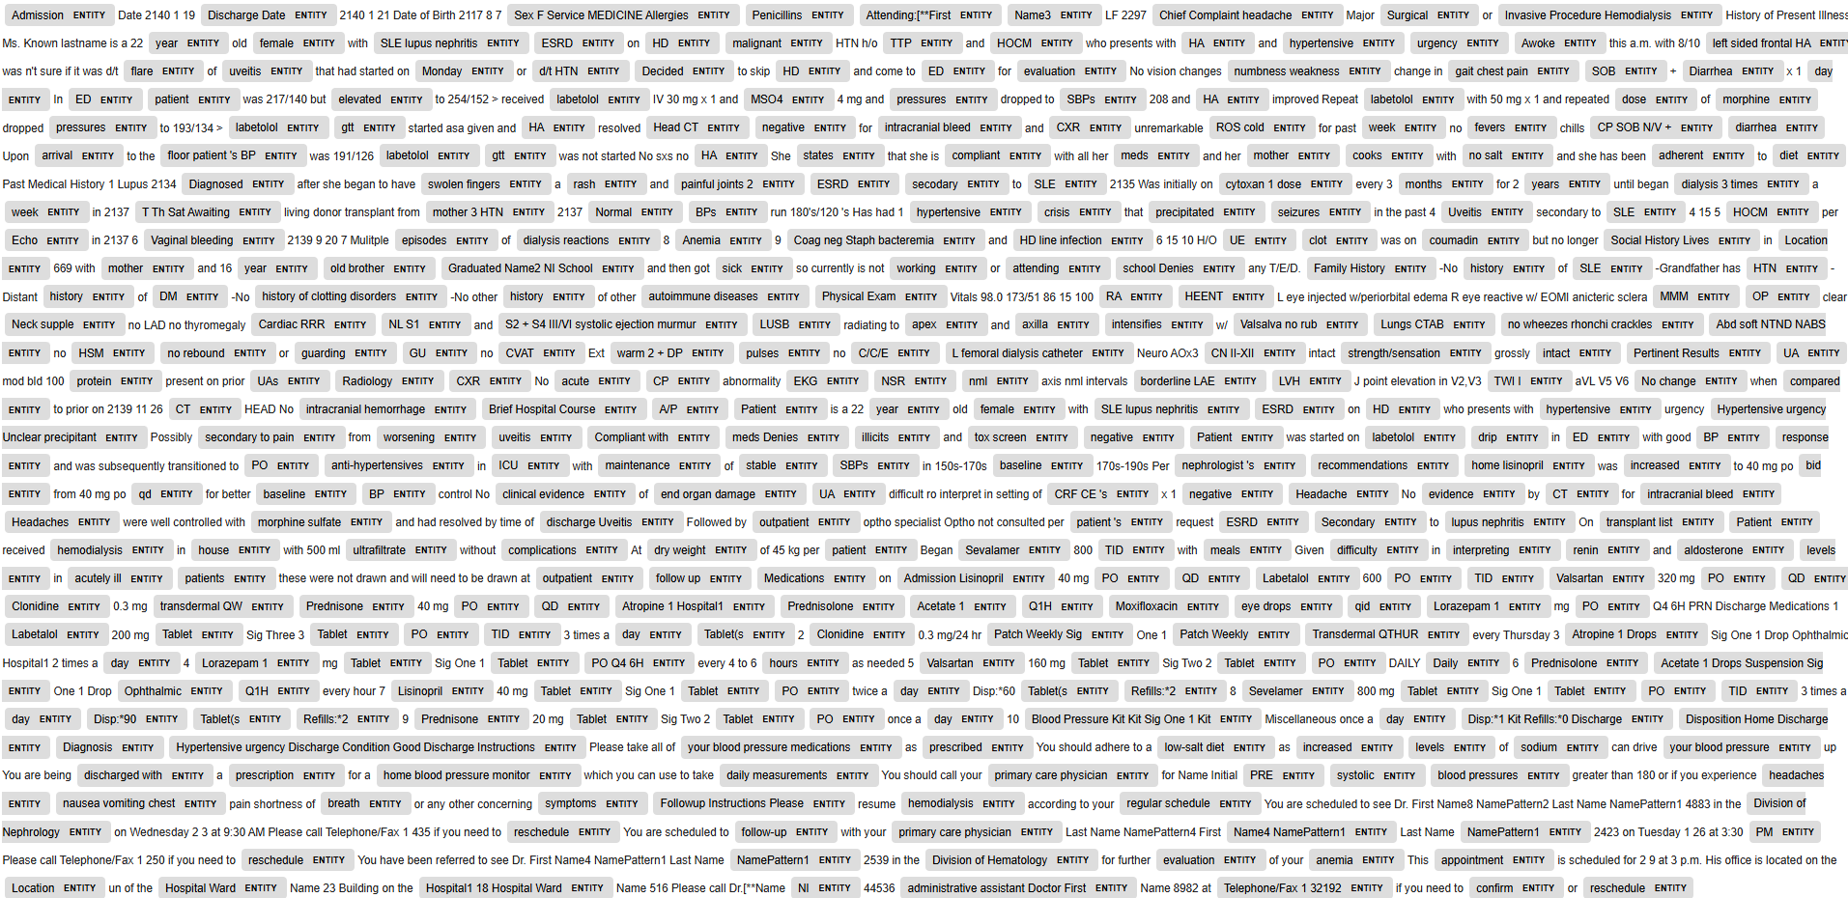
Visualize SciSpaCy Entities Using displaCy

Slide 13
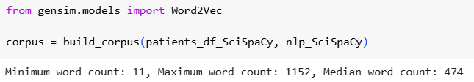
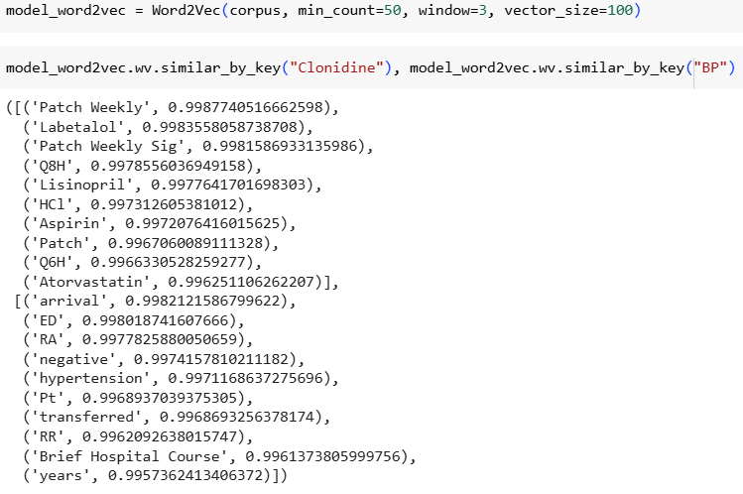

Word2Vec and t-SNE Visualization Using SciSpaCy-Processed Data
Build corpus using SciSpaCy
Plot t-SNE

Slide 14
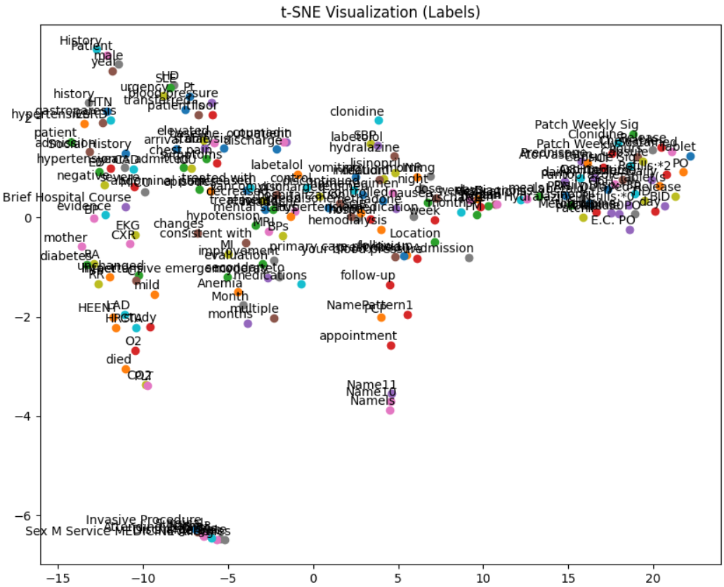
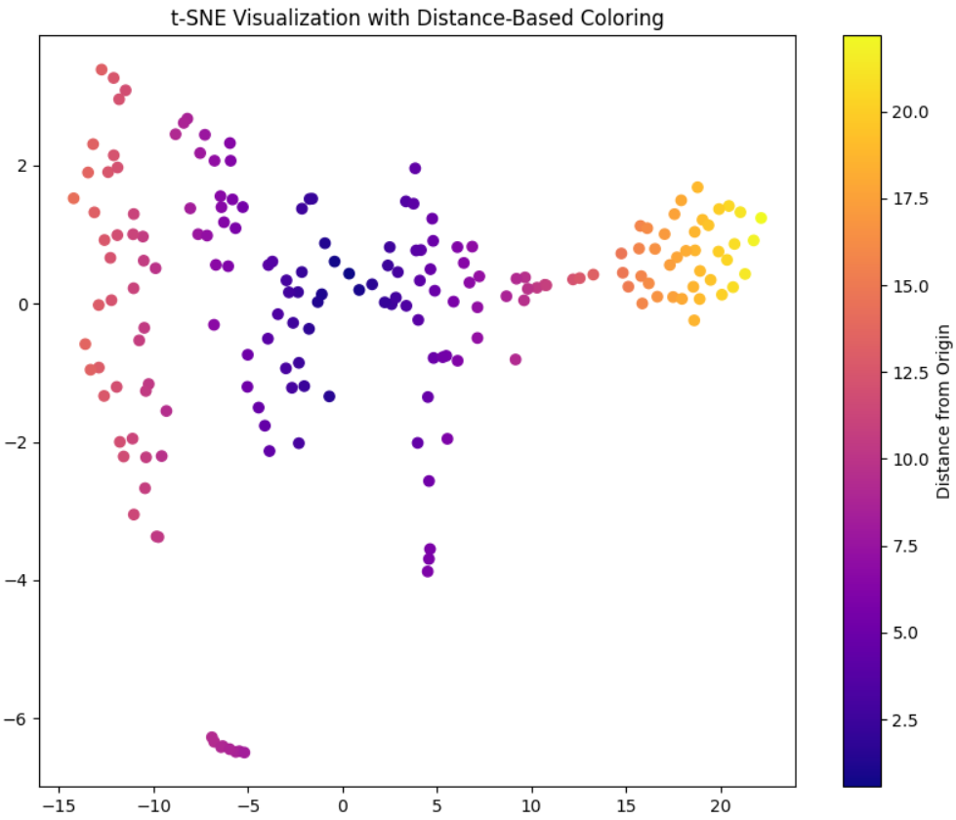

Slide 15
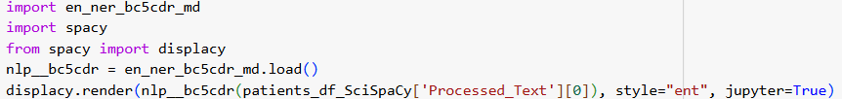
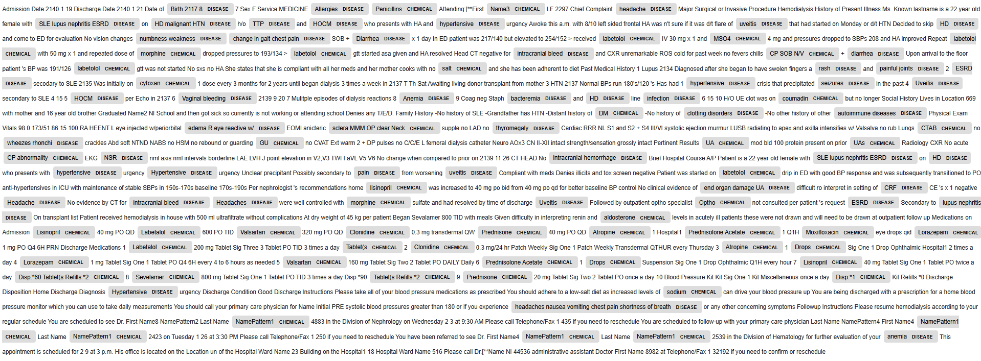
en_ner_bc5cdr_md Visualization Using SciSpaCy-Processed Data
en_ner_bc5cdr_md is a Named Entity Recognition (NER) model from SciSpaCy that specializes in identifying diseases and chemicals in text

Slide 16
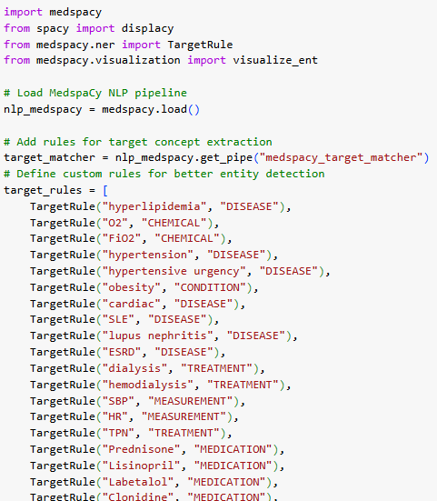
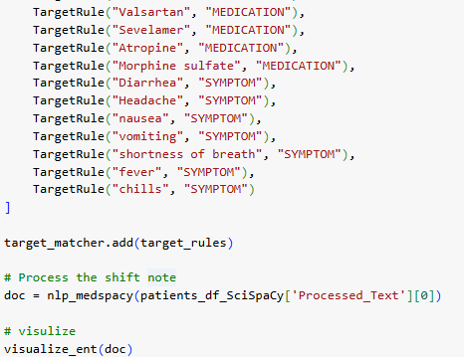
MedSpacy Visualization Using SciSpaCy-Processed Data
MedSpaCy is a library designed for processing clinical and biomedical text.
In this code, MedSpaCy is being enhanced by adding custom target rules to better detect specific medical entities such as diseases, treatments, symptoms, and medications in clinical notes.

Slide 17
